Slide 1
Discretisation using FEM
Namshad Thekkethil
Namshad.Thekkethil@glasgow.ac.uk
School of Mathematics & Statistics
University of Glasgow

Slide 2



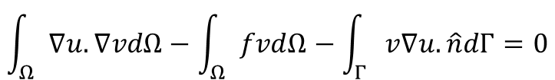


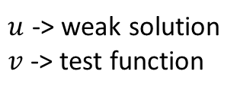
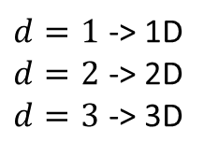
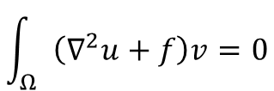


Strong and weak form
$d=1$ -> 1D
$d=2$ -> 2D
$d=3$ -> 3D
$x∈Ω⊂ℝ^{d}$ -> Spatial variable
$$Γ$$
$u\left(x\right)$ -> Dependent variable
$$u:Ω→ℝ$$
$$Ω$$
Strong form
$1D$ -> $\frac{d^{2}u}{dx^{2}}+f=0$
$$∇^{2}u+f=0$$
Weak form
$$\int_{Ω}{\left(∇^{2}u+f\right)v}=0$$
$u$ -> weak solution
$v$ -> test function
$$\int_{Ω}{∇u.∇vdΩ}−\int_{Ω}{fvdΩ}−\int_{Γ}{v∇u.\hat{n}dΓ}=0$$
Continuity condition is relaxed for the weak form

Slide 3





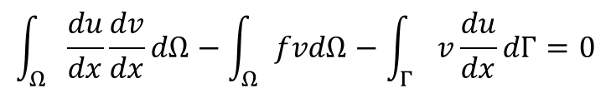













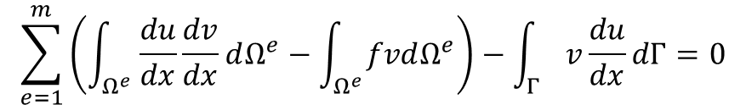


Discretisation of weak form
$$Ω$$
1D Heat equation
$$1$$
$$2$$
$$e$$
$$m$$
$$Γ$$
$$Γ$$
Strong form
$e=1$ to $m$
$$\frac{d^{2}u}{dx^{2}}+f=0$$
Weak form
$$\int_{Ω}{\frac{du}{dx}\frac{dv}{dx}dΩ}−\int_{Ω}{fvdΩ}−\int_{Γ}{v\frac{du}{dx}dΓ}=0$$
$x=0$, $u=a$
$x=1$, $\frac{du}{dx}=b$
$$\sum_{e=1}^{m}{\left(\int_{Ω^{e}}{\frac{du}{dx}\frac{dv}{dx}dΩ^{e}}−\int_{Ω^{e}}{fvdΩ^{e}}\right)}−\int_{Γ}{v\frac{du}{dx}dΓ}=0$$
For each element $e$, assume linear variation of $u$
$$u=p+qx$$
$$e$$
$$u=\frac{x−x_{e2}}{x_{e1}−x_{e2}}u^{e1}+\frac{x_{e1}−x}{x_{e1}−x_{e2}}u^{e2}$$
$$e1$$
$$e2$$
$$u^{e1}=p+qx_{e1}$$
$$u^{e2}=p+qx_{e2}$$
$$u=φ_{e1}u^{e1}+φ_{e2}u^{e2}$$
$$u=\sum_{j=e1}^{e2}{φ_{j}u^{j}}$$
$φ_{e1}$, $φ_{e2}$ -> Shape functions

Slide 4
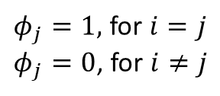











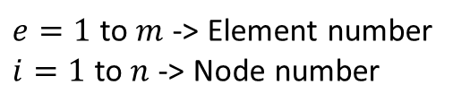





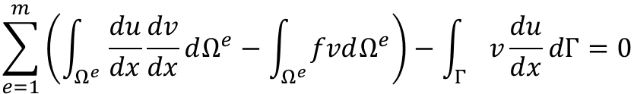
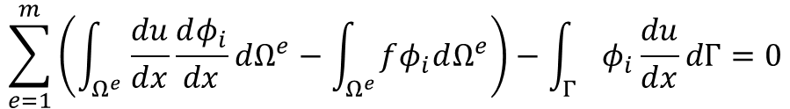





Shape function
$$1.0$$
$$φ_{e1}$$
$$u=\sum_{j=e1}^{e2}{φ_{j}u^{j}}$$
$$φ_{e2}$$
$$e$$
$$φ_{e1}=\frac{x−x_{e2}}{x_{e1}−x_{e2}},φ_{e2}=\frac{x_{e2}−x}{x_{e1}−x_{e2}}$$
$$e1$$
$$e2$$
$$1$$
$$2$$
$$e$$
$$m$$
$$φ$$
$φ_{j}=1,$ for $i=j$
$φ_{j}=0$, for $i≠j$
$$1$$
$$2$$
$$i−1$$
$$i$$
$$i+1$$
$$n$$
$$i=1,2,…n$$
$e=1$ to $m$ -> Element number
$i=1$ to $n$ -> Node number
The shape function $φ_{i}$ is a test function $v$
Galerkin method
$$\sum_{e=1}^{m}{\left(\int_{Ω^{e}}{\frac{du}{dx}\frac{dv}{dx}dΩ^{e}}−\int_{Ω^{e}}{fvdΩ^{e}}\right)}−\int_{Γ}{v\frac{du}{dx}dΓ}=0$$
$$\sum_{e=1}^{m}{\left(\int_{Ω^{e}}{\frac{du}{dx}\frac{dφ_{i}}{dx}dΩ^{e}}−\int_{Ω^{e}}{fφ_{i}dΩ^{e}}\right)}−\int_{Γ}{φ_{i}\frac{du}{dx}dΓ}=0$$
$$i=1,2,…n$$

Slide 5


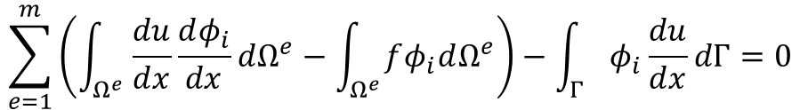




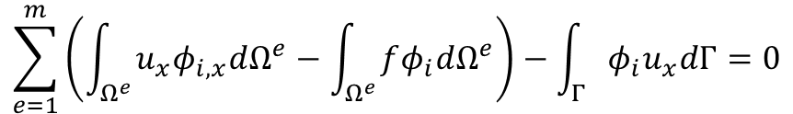
Shape function
$$Ω$$
$$1$$
$$2$$
$$e$$
$$m$$
$$Γ$$
$$Γ$$
$$1$$
$$2$$
$$i−1$$
$$i$$
$$i+1$$
$$n$$
$$\sum_{e=1}^{m}{\left(\int_{Ω^{e}}{\frac{du}{dx}\frac{dφ_{i}}{dx}dΩ^{e}}−\int_{Ω^{e}}{fφ_{i}dΩ^{e}}\right)}−\int_{Γ}{φ_{i}\frac{du}{dx}dΓ}=0$$
$$i=1,2,…n$$
$$φ_{i,x}=\frac{dφ_{i}}{dx},u_{x}=\frac{du}{dx}$$
$$\sum_{e=1}^{m}{\left(\int_{Ω^{e}}{u_{x}φ_{i,x}dΩ^{e}}−\int_{Ω^{e}}{fφ_{i}dΩ^{e}}\right)}−\int_{Γ}{φ_{i}u_{x}dΓ}=0$$
$$i=1,2,…n$$

Slide 6

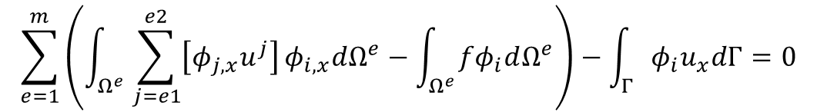

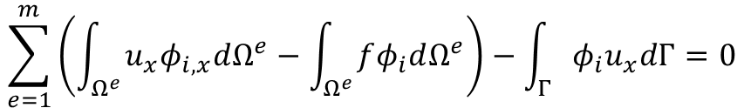



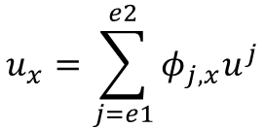

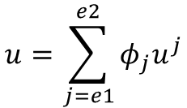

$$Ω$$
$$1$$
$$2$$
$$e$$
$$m$$
$$Γ$$
$$Γ$$
$$1$$
$$2$$
$$i−1$$
$$i$$
$$i+1$$
$$n$$
$$\sum_{e=1}^{m}{\left(\int_{Ω^{e}}{u_{x}φ_{i,x}dΩ^{e}}−\int_{Ω^{e}}{fφ_{i}dΩ^{e}}\right)}−\int_{Γ}{φ_{i}u_{x}dΓ}=0$$
$$i=1,2,…,n$$
$$φ_{e1}$$
Linear interpolation
$$u=\sum_{j=e1}^{e2}{φ_{j}u^{j}}$$
$$u_{x}=\sum_{j=e1}^{e2}{φ_{j,x}u^{j}}$$
$$φ_{e2}$$
$$e$$
$$e1$$
$$e2$$
$$\sum_{e=1}^{m}{\left(\int_{Ω^{e}}{\sum_{j=e1}^{e2}{\left[φ_{j,x}u^{j}\right]}φ_{i,x}dΩ^{e}}−\int_{Ω^{e}}{fφ_{i}dΩ^{e}}\right)}−\int_{Γ}{φ_{i}u_{x}dΓ}=0$$
$$i=1,2,…,n$$

Slide 7
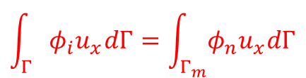








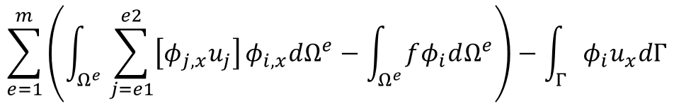






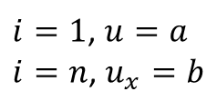




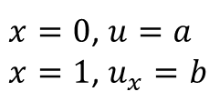




Discretised Equations
$$\sum_{e=1}^{m}{\left(\int_{Ω^{e}}{\sum_{j=e1}^{e2}{\left[φ_{j,x}u_{j}\right]}φ_{i,x}dΩ^{e}}−\int_{Ω^{e}}{fφ_{i}dΩ^{e}}\right)}−\int_{Γ}{φ_{i}u_{x}dΓ}$$
$$\sum_{e=1}^{m}{K^{e}u^{e}}=\sum_{e=1}^{m}{r^{e}}$$
$$i=1,2,…,n$$
Boundary conditions,
$$Ω$$
$x=0$, $u=a$
$x=1$, $u_{x}=b$
$$1$$
$$2$$
$$e$$
$$m$$
$$Γ$$
$$Γ$$
On $Γ$,
$$1$$
$$2$$
$$e1$$
$$e2$$
$$n$$
$i=1$, $u=a$
$i=n$, $u_{x}=b$
$$\int_{Γ}{φ_{i}u_{x}dΓ}=\int_{Γ_{m}}{φ_{n}u_{x}dΓ}$$
On $Γ^{m}$,
$$φ_{n}=1,u_{x}=b$$
$$\int_{Γ_{m}}{φ_{n}u_{x}dΓ}=b$$
For interior element $e$,
For $e=1$, $u^{1}=a$
For $e=m$, $u^{n}=b$
$$K^{e}=\left[\begin{matrix}φ_{e1,x}φ_{e1,x} & φ_{e1,x}φ_{e2,x} \\ φ_{e2,x}φ_{e1,x} & φ_{e2,x}φ_{e2,x}\end{matrix}\right]Ω^{e}$$
$$K^{m} =\left[\begin{matrix}φ_{n−1,x}φ_{n−1,x} & φ_{n−1,x}φ_{n,x} \\ φ_{n,x}φ_{n−1,x} & φ_{n,x}φ_{n,x}\end{matrix}\right]Ω^{m}$$
$$K^{1}=\left[\begin{matrix}1 & 0 \\ φ_{2,x}φ_{1,x} & φ_{2,x}φ_{2,x}\end{matrix}\right]Ω^{1}$$
$$u^{1}=\left[\begin{matrix}u^{1} \\ u^{2}\end{matrix}\right]$$
$$r^{1}=\left[\begin{matrix}a \\ fΩ^{1}\end{matrix}\right]$$
$$u^{e} =\left[\begin{matrix}u^{e1} \\ u^{e2}\end{matrix}\right]$$
$$r^{e}=fΩ^{e}\left[\begin{matrix}1 \\ 1\end{matrix}\right]$$
$$u^{m} =\left[\begin{matrix}u^{n−1} \\ u^{n}\end{matrix}\right]$$
$$r^{m}=fΩ^{m}\left[\begin{matrix}1 \\ 1\end{matrix}\right]+\left[\begin{matrix}0 \\ b\end{matrix}\right]$$

Slide 8
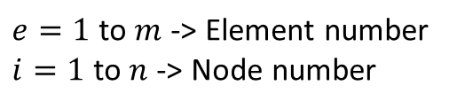



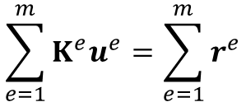




























Final equations
$$1$$
$$2$$
$$3$$
$$e$$
$$m−1$$
$$m$$
$$Γ$$
$$Γ$$
$$1$$
$$2$$
$$3$$
$$4$$
$$i$$
$$n−1$$
$$n$$
$$\sum_{e=1}^{m}{K^{e}u^{e}}=\sum_{e=1}^{m}{r^{e}}$$
$e=1$ to $m$ -> Element number
$i=1$ to $n$ -> Node number
$$Ku=r$$
$$1$$
$$0$$
$$u^{1}$$
$$φ_{2,x}φ_{1,x}Ω^{1}$$
$$φ_{2,x}φ_{2,x}Ω^{1}$$
$$+φ_{2,x}φ_{2,x}Ω^{2}$$
$$φ_{2,x}φ_{3,x}Ω^{2}$$
$$u^{2}$$
$φ_{3,x}φ_{2,x}$ $Ω^{2}$
$φ_{3,x}φ_{3,x}$ $Ω^{2}$
$+φ_{3,x}φ_{3,x}$ $Ω^{2}$
$$u^{3}$$
$$⋱$$
$$⋮$$
$$φ_{n−1,x}φ_{n−1,x}Ω^{m−1}+$$
$φ_{n−1,x}φ_{n−1,x}$ $Ω^{m}$
$$φ_{n−1,x}φ_{n,x}Ω^{m}$$
$$u^{n−1}$$
$$φ_{n,x}φ_{n−1,x}Ω^{m}$$
$$φ_{n,x}φ_{n,x}Ω^{m}$$
$$u^{n}$$
Global stiffness matrix

Slide 9
















$$1$$
$$2$$
$$e$$
$$m$$
$$1$$
$$2$$
$$i$$
$$n$$
$$1$$
$$0$$
$$u^{1}$$
$$φ_{2,x}φ_{1,x}Ω^{1}$$
$$φ_{2,x}φ_{2,x}Ω^{1}$$
$$+φ_{2,x}φ_{2,x}Ω^{2}$$
$$φ_{2,x}φ_{3,x}Ω^{2}$$
$$u^{2}$$
$φ_{3,x}φ_{2,x}$ $Ω^{2}$
$φ_{3,x}φ_{3,x}$ $Ω^{2}$
$+φ_{3,x}φ_{3,x}$ $Ω^{2}$
$$u^{3}$$
$$⋱$$
$$⋮$$
$$φ_{n−1,x}φ_{n−1,x}Ω^{m−1}+$$
$φ_{n−1,x}φ_{n−1,x}$ $Ω^{m}$
$$φ_{n−1,x}φ_{n,x}Ω^{m}$$
$$u^{n−1}$$
$$φ_{n,x}φ_{n−1,x}Ω^{m}$$
$$φ_{n,x}φ_{n,x}Ω^{m}$$
$$u^{n}$$
$$a$$
$$0$$
$$f \left(Ω^{1}+Ω^{2}\right)$$
$$0$$
$$=$$
$$⋮$$
$$+$$
$$⋮$$
$$f\left(Ω^{m−1}+Ω^{m}\right)$$
$$0$$
$${fΩ}^{m}$$
$$b$$

Slide 10



























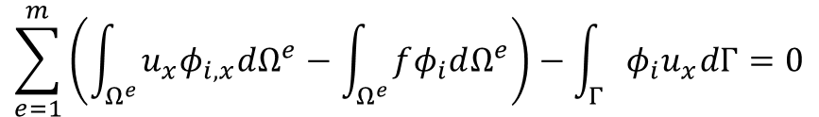



Second order
$$1$$
$$2$$
$$e$$
$$m$$
$$1$$
$$2$$
$$3$$
$$n−1$$
$$n$$
$$\sum_{e=1}^{m}{\left(\int_{Ω^{e}}{u_{x}φ_{i,x}dΩ^{e}}−\int_{Ω^{e}}{fφ_{i}dΩ^{e}}\right)}−\int_{Γ}{φ_{i}u_{x}dΓ}=0$$
$$u=φ_{e1}u^{e1}+φ_{e2}u^{e2}+φ_{e3}u^{e3}$$
$$i=1,2,…,n$$
$$φ_{e1}=\frac{\left(x_{2}−x\right)\left(x_{3}−x\right)}{\left(x_{2}−x_{1}\right)\left(x_{3}−x_{1}\right)}$$
For each element $e$, assume quadratic variation of $u$
$$u=\sum_{j=e1}^{e3}{φ_{j}u^{j}}$$
$$u=p+qx+rx^{2}$$
$$φ_{e2}=\frac{\left(x_{1}−x\right)\left(x_{3}−x\right)}{\left(x_{1}−x_{2}\right)\left(x_{3}−x_{2}\right)}$$
$$u^{e1}=p+qx_{e1}+rx_{e1}^{2}$$
$$e$$
$$u^{e2}=p+qx_{e2}+rx_{e2}^{2}$$
$$φ_{e2}=\frac{\left(x_{1}−x\right)\left(x_{2}−x\right)}{\left(x_{1}−x_{3}\right)\left(x_{2}−x_{3}\right)}$$
$$e1$$
$e$3
$$e2$$
$$u^{e3}=p+qx_{e3}+rx_{e3}^{2}$$
$$φ_{e1}$$
$$φ_{e3}$$
$$e$$
$$φ_{e2}$$
$$e1$$
$$e3$$
$$e2$$

Slide 11

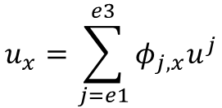


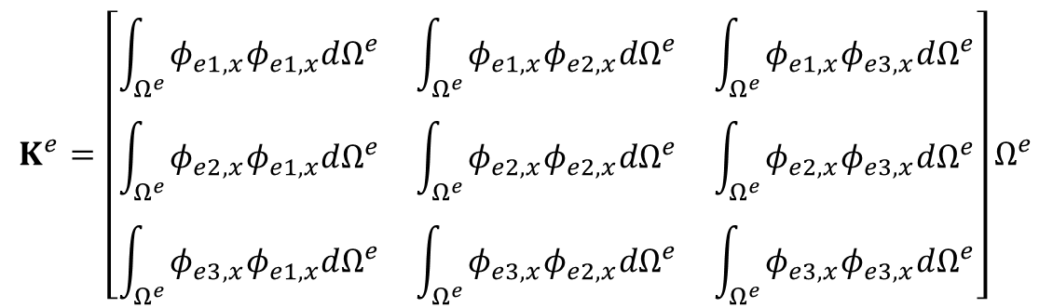
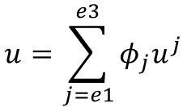



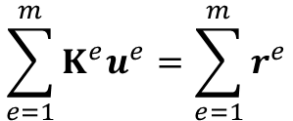
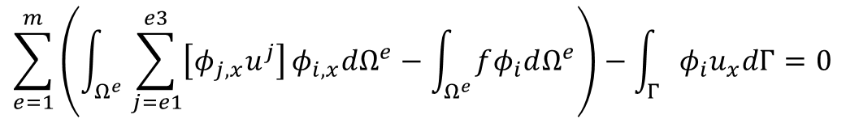


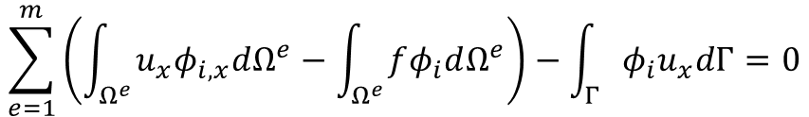




$$\sum_{e=1}^{m}{\left(\int_{Ω^{e}}{u_{x}φ_{i,x}dΩ^{e}}−\int_{Ω^{e}}{fφ_{i}dΩ^{e}}\right)}−\int_{Γ}{φ_{i}u_{x}dΓ}=0$$
$$i=1,2,…,n$$
$$φ_{e1}$$
$$u=\sum_{j=e1}^{e3}{φ_{j}u^{j}}$$
$$u_{x}=\sum_{j=e1}^{e3}{φ_{j,x}u^{j}}$$
$$φ_{e2}$$
Quadratic interpolation
$$e$$
$$φ_{e3}$$
$$\sum_{e=1}^{m}{\left(\int_{Ω^{e}}{\sum_{j=e1}^{e3}{\left[φ_{j,x}u^{j}\right]}φ_{i,x}dΩ^{e}}−\int_{Ω^{e}}{fφ_{i}dΩ^{e}}\right)}−\int_{Γ}{φ_{i}u_{x}dΓ}=0$$
$$e1$$
$$e3$$
$$e2$$
$$i=1,2,…,n$$
$$\sum_{e=1}^{m}{K^{e}u^{e}}=\sum_{e=1}^{m}{r^{e}}$$
For interior element $e$,
$$K^{e}=\left[\begin{matrix}\int_{Ω^{e}}{φ_{e1,x}φ_{e1,x}dΩ^{e}} & \int_{Ω^{e}}{φ_{e1,x}φ_{e2,x}dΩ^{e}} & \int_{Ω^{e}}{φ_{e1,x}φ_{e3,x}dΩ^{e}} \\ \int_{Ω^{e}}{φ_{e2,x}φ_{e1,x}dΩ^{e}} & \int_{Ω^{e}}{φ_{e2,x}φ_{e2,x}dΩ^{e}} & \int_{Ω^{e}}{φ_{e2,x}φ_{e3,x}dΩ^{e}} \\ \int_{Ω^{e}}{φ_{e3,x}φ_{e1,x}dΩ^{e}} & \int_{Ω^{e}}{φ_{e3,x}φ_{e2,x}dΩ^{e}} & \int_{Ω^{e}}{φ_{e3,x}φ_{e3,x}dΩ^{e}}\end{matrix}\right]Ω^{e}$$
$$u^{e}=\left[\begin{matrix}u^{1} \\ u^{2} \\ u^{3}\end{matrix}\right]$$
$$r^{e}=\dot{q}Ω^{e}\left[\begin{matrix}1 \\ 1 \\ 1\end{matrix}\right]$$

Slide 12
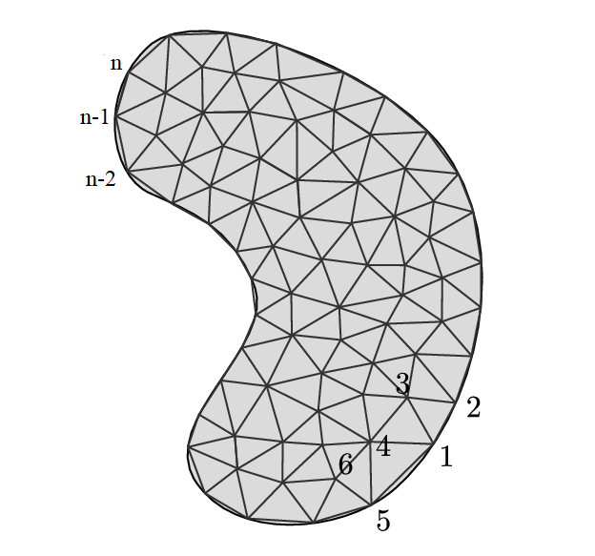


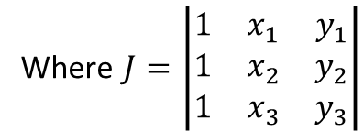
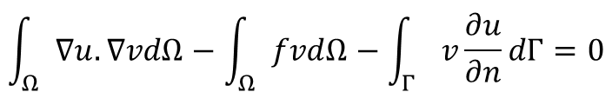















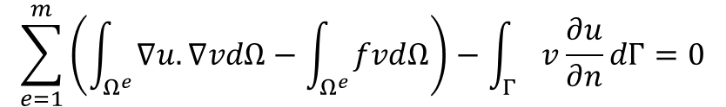
2D Heat equation
$$Γ$$
$$Ω$$
Strong form
Weak form
$$\int_{Ω}{∇u.∇vdΩ}−\int_{Ω}{fvdΩ}−\int_{Γ}{v\frac{∂u}{∂n}dΓ}=0$$
$$∇^{2}u+f=0$$
$$\sum_{e=1}^{m}{\left(\int_{Ω^{e}}{∇u.∇vdΩ}−\int_{Ω^{e}}{fvdΩ}\right)}−\int_{Γ}{v\frac{∂u}{∂n}dΓ}=0$$
$$u=\sum_{j=e1}^{e3}{φ_{j}u^{j}}$$
For each element $e$, assume linear variation of $u$
$$u=p+qx+ry$$
$$u=φ_{e1}u^{e1}+φ_{e2}u^{e2}+φ_{e3}u^{e3}$$
$$e3$$
$$u^{e3}=p+qx_{e3}+ry_{e3}$$
$$φ_{e1}=\frac{x_{e2}y_{e3}−x_{e3}y_{e2}+\left(y_{e2}−y_{e3}\right)x+\left(x_{e3}−x_{e2}\right)y}{J}$$
$$φ_{e2}=\frac{x_{e3}y_{e1}−x_{e1}y_{e2}+\left(y_{e3}−y_{e1}\right)x+\left(x_{e1}−x_{e3}\right)y}{J}$$
$$Γ^{e}$$
$$φ_{e3}=\frac{x_{e1}y_{e2}−x_{e2}y_{e1}+\left(y_{e1}−y_{e2}\right)x+\left(x_{e2}−x_{e1}\right)y}{J}$$
$$Ω^{e}$$
Where $J=\left|\begin{matrix}1 & x_{1} & y_{1} \\ 1 & x_{2} & y_{2} \\ 1 & x_{3} & y_{3}\end{matrix}\right|$
$$e1$$
$$e2$$
$$u^{e1}=p+qx_{e1}+ry_{e1}$$
$$u^{e2}=p+qx_{e2}+ry_{e2}$$

Slide 13
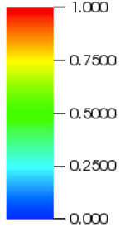
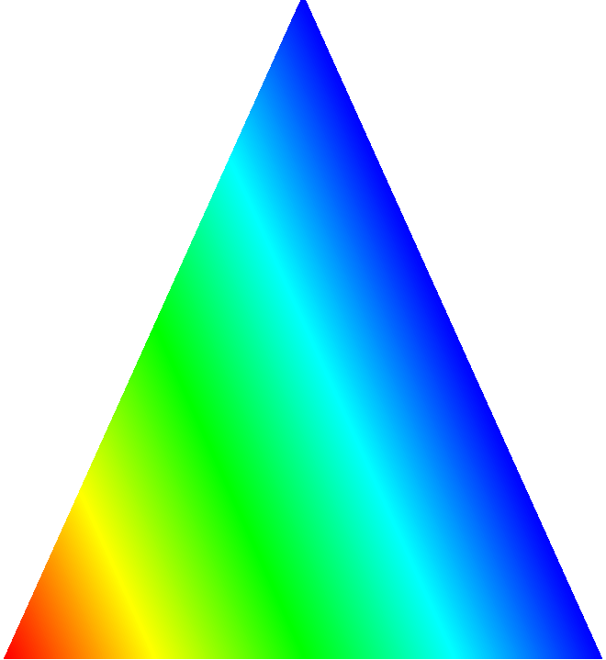
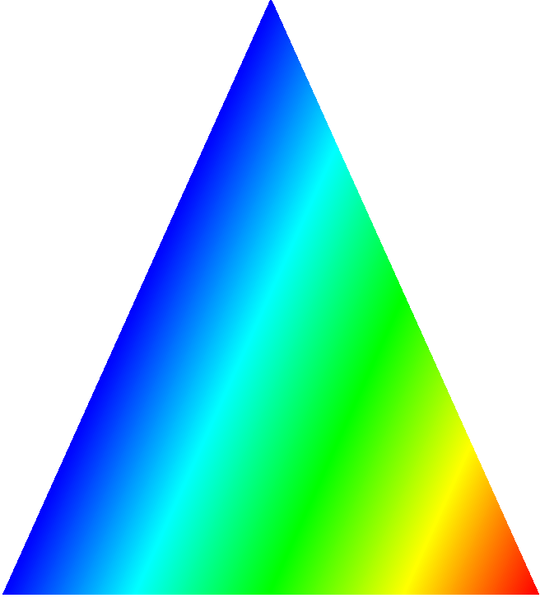
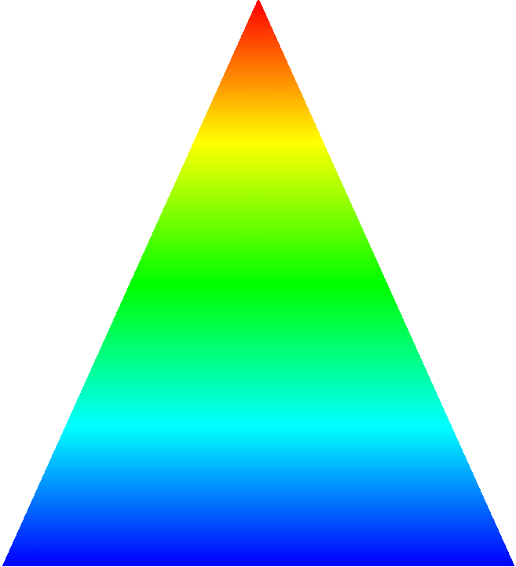









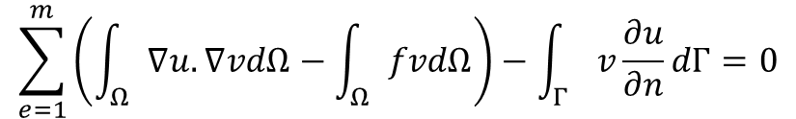




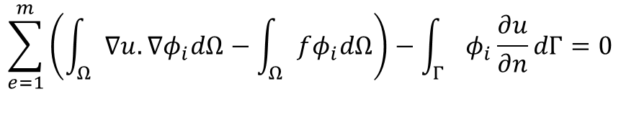

$$e3$$
$$Γ^{e}$$
$$Γ$$
$$Ω$$
$$Ω^{e}$$
$$e1$$
$$e2$$
$$e3$$
$$e1$$
$$φ_{e1}$$
$$φ_{e2}$$
$$e2$$
$$φ_{e3}$$
Galerkin method
$$\sum_{e=1}^{m}{\left(\int_{Ω}{∇u.∇vdΩ}−\int_{Ω}{fvdΩ}\right)}−\int_{Γ}{v\frac{∂u}{∂n}dΓ}=0$$
$$\sum_{e=1}^{m}{\left(\int_{Ω}{∇u.∇φ_{i}dΩ}−\int_{Ω}{fφ_{i}dΩ}\right)}−\int_{Γ}{φ_{i}\frac{∂u}{∂n}dΓ}=0$$
$$i=1,2,…,n$$

Slide 14
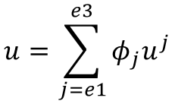







$$\sum_{e=1}^{m}{\left(\int_{Ω^{e}}{∇u.∇φ_{i}dΩ^{e}}−\int_{Ω^{e}}{fφ_{i}dΩ^{e}}\right)}−\int_{Γ}{φ_{i}\frac{∂u}{∂n}dΓ}$$
$$i=1,2,…,n$$
$$e3$$
$$u=\sum_{j=e1}^{e3}{φ_{j}u^{j}}$$
$$u_{x}=\sum_{j=e1}^{e3}{φ_{j,x}u^{j}}$$
$$u_{y}=\sum_{j=1e3}{φ_{j,y}u^{j}}$$
$$Γ^{e}$$
Linear interpolation
$$Ω^{e}$$
$$∇u.∇φ_{i}=φ_{i,x}\sum_{j=e1}^{e3}{φ_{j,x}u^{j}}+φ_{i,y}\sum_{j=e1}^{e3}{φ_{j,y}u^{j}}$$
$$e1$$
$$e2$$
$$\sum_{e=1}^{m}{\left(\int_{Ω^{e}}{\left[φ_{i,x}\sum_{j=e1}^{e3}{\left(φ_{j,x}u^{j}\right)}+φ_{i,y}\sum_{j=e1}^{e3}{\left(φ_{j,y}u^{j}\right)}\right]dΩ^{e}}−\int_{Ω^{e}}{fφ_{i}dΩ^{e}}\right)}−\int_{Γ}{φ_{i}\frac{∂u}{∂n}dΓ}$$
$$i=1,2,…,n$$

Slide 15












Discretised Equations
$$\sum_{e=1}^{m}{\left(\int_{Ω^{e}}{\left[φ_{i,x}\sum_{j=e1}^{e3}{\left(φ_{j,x}u^{j}\right)}+φ_{i,y}\sum_{j=e1}^{e3}{\left(φ_{j,y}u^{j}\right)}\right]dΩ^{e}}−\int_{Ω^{e}}{fφ_{i}dΩ^{e}}\right)}−\int_{Γ}{φ_{i}\frac{∂u}{∂n}dΓ}$$
$$\sum_{e=1}^{m}{K^{e}u^{e}}=\sum_{e=1}^{m}{r^{e}}$$
$$i=1,2,…,n$$
For interior elements $e$
$$K^{e}=\left[\begin{matrix}φ_{e1,x}φ_{e1,x}+φ_{e1,y}φ_{e1,y} & φ_{e1,x}φ_{e2,x}+φ_{e1,y}φ_{e2,y} & φ_{e1,x}φ_{e3,x}+φ_{e1,y}φ_{e3,y} \\ φ_{e2,x}φ_{e1,x}+φ_{e2,y}φ_{e1,y} & φ_{e2,x}φ_{e2,x}+φ_{e2,y}φ_{e2,y} & φ_{e2,x}φ_{e3,x}+φ_{e2,y}φ_{e3,y} \\ φ_{e3,x}φ_{e1,x}+φ_{e3,y}φ_{e3,y} & φ_{e3,x}φ_{e2,x}+φ_{e3,y}φ_{e2,y} & φ_{e3,x}φ_{e3,x}+φ_{e3,y}φ_{e3,y}\end{matrix}\right]Ω^{e}$$
$$\frac{∂u}{∂n}=b$$
$$e3$$
For $i$ on the elements of the boundary $Γ^{1}$,
$$Γ^{2}$$
$$Γ^{e}$$
$$u^{i}=a$$
$$Ω^{e}$$
$$u=a$$
$$e1$$
$$e2$$
$$Γ^{1}$$
$$\int_{Γ}{φ_{i}\frac{∂u}{∂n}dΓ}=\int_{Γ^{2}}{φ_{i}\frac{∂u}{∂n}dΓ}=b\int_{Γ^{2}}{φ_{i}dΓ}$$

Slide 16


























Second order
$$e3$$
$$u=p+qx+ry+sx^{2}+txy+uy^{2}$$
$$Γ^{e}$$
$$e6$$
$$u^{e1}=p+qx_{e1}+ry_{e1}+sx_{e1}^{2}+tx_{e1}y_{e1}+uy_{e1}^{2}$$
$$e5$$
$$Ω^{e}$$
$$u^{e2}=p+qx_{e2}+ry_{e2}+sx_{e2}^{2}+tx_{e2}y_{e2}+uy_{e2}^{2}$$
$$u^{e3}=p+qx_{e3}+ry_{e3}+sx_{e3}^{2}+tx_{e3}y_{e3}+uy_{e3}^{2}$$
$$e1$$
$$e4$$
$$e2$$
$$u^{e4}=p+qx_{e4}+ry_{e4}+sx_{e4}^{2}+tx_{e2}y_{e4}+uy_{e4}^{2}$$
$$u^{e5}=p+qx_{e5}+ry_{e5}+sx_{e5}^{2}+tx_{e5}y_{e5}+uy_{e5}^{2}$$
$$u^{e6}=p+qx_{e6}+ry_{e6}+sx_{e6}^{2}+tx_{e6}y_{e6}+uy_{e6}^{2}$$
$$u=φ_{e1}u^{e1}+φ_{e2}u^{e2}+φ_{e3}u^{e3}+φ_{e4}u^{e4}+φ_{e5}u^{e5}+φ_{e6}u^{e6}$$
$$φ_{e3}$$
$$φ_{e4}$$
$$φ_{e5}$$
$$φ_{e6}$$
$$φ_{e1}$$
$$φ_{e2}$$
$$e3$$
$$e5$$
$$e6$$
$$e1$$
$$e2$$
$$e4$$

Slide 17





FEM Software
$$\sum_{e=1}^{m}{K^{e}u^{e}}=\sum_{e=1}^{m}{r^{e}}$$
$$Ku=r$$
https://libmesh.github.io/

